Slide 1

Final Project
Sim Young Jin 20171298

Slide 2
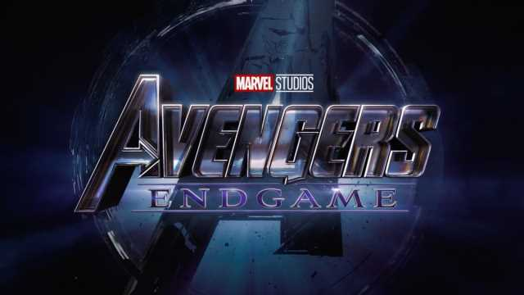
GOAL
The MARVEL Avengers is one of the most sensational movie in the world.
What’s more, it gained popularity especially in Korea regardless of age,
from young to old.
I wondered why many people loves Avengers despite its complex fictional world and large number of characters.
I decided to analyze Avengers: Endgame using network method to find that reason.

Slide 3
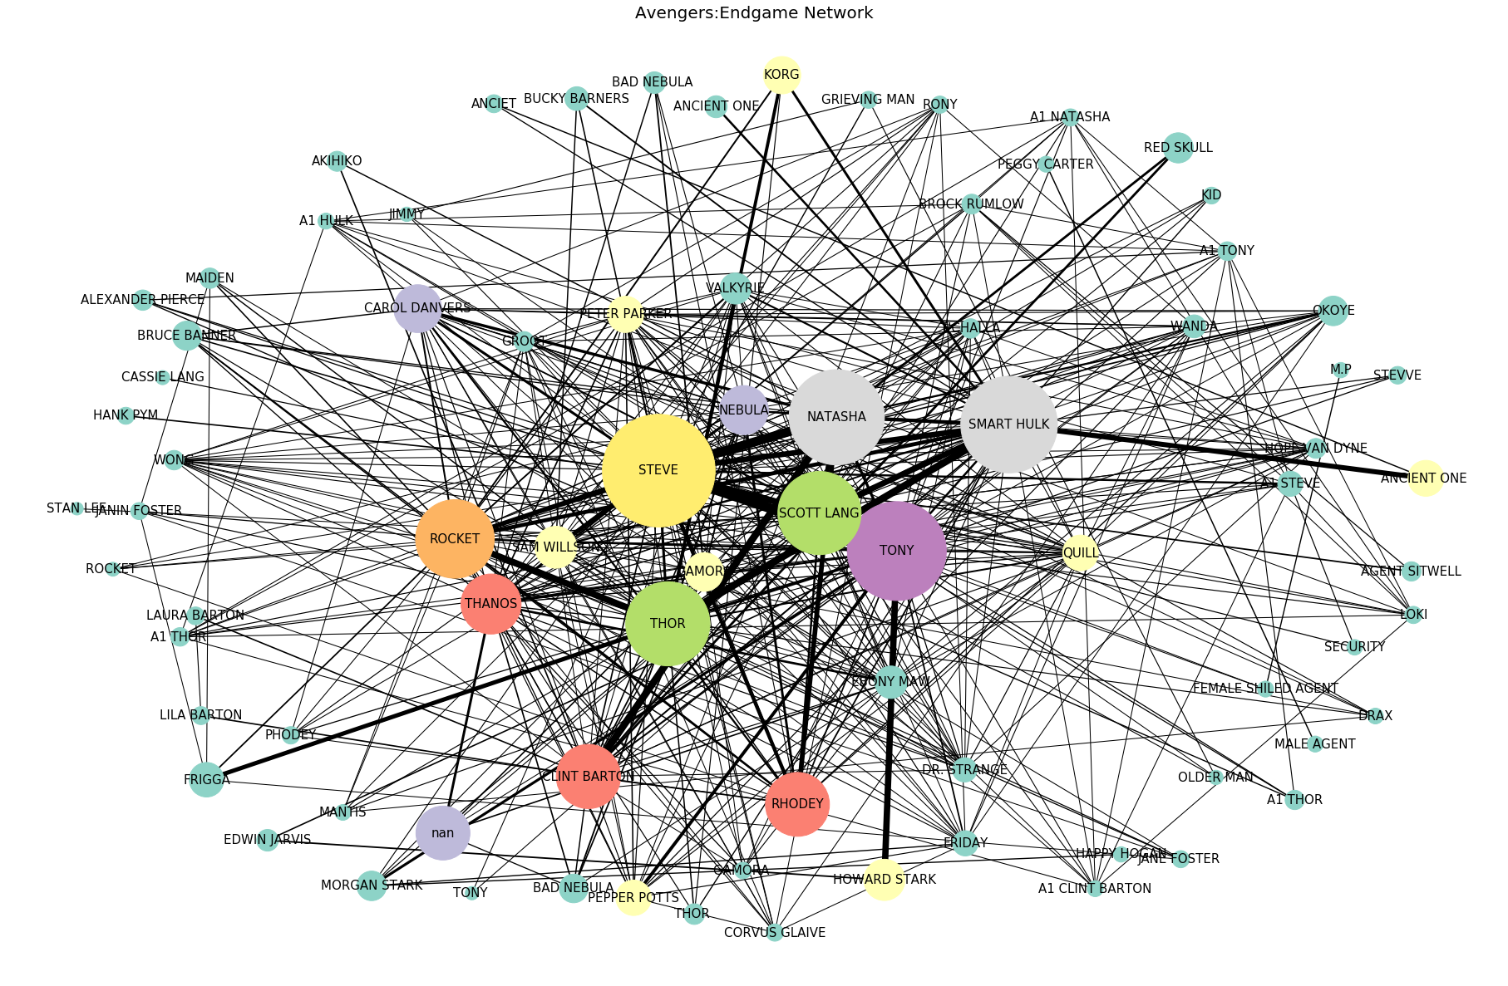
The full network

Slide 4
Division
Part1
: Reunion
Part2
: Time travel
Part3
: Final battle

Slide 5
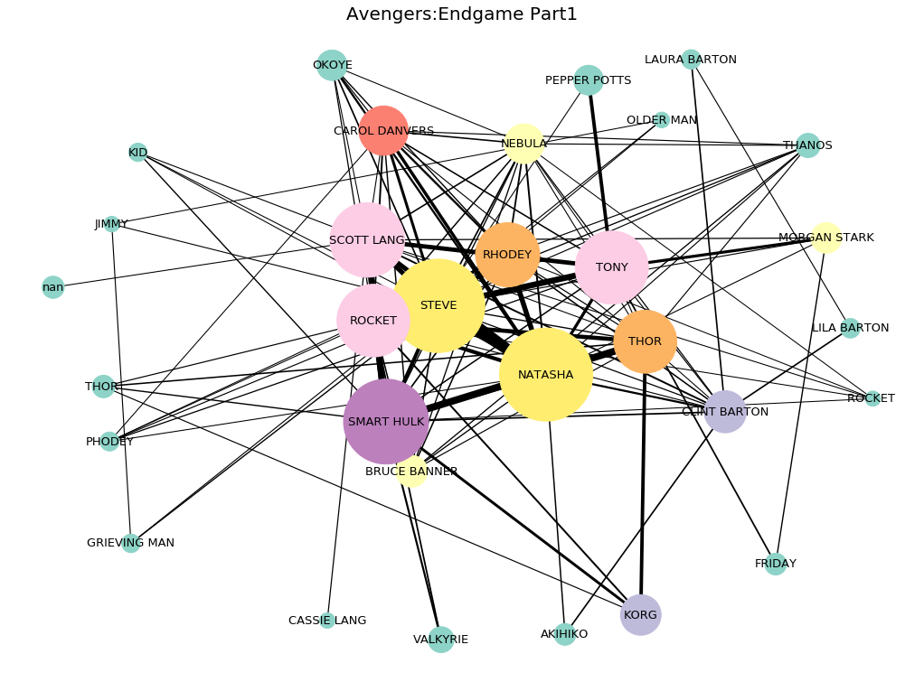
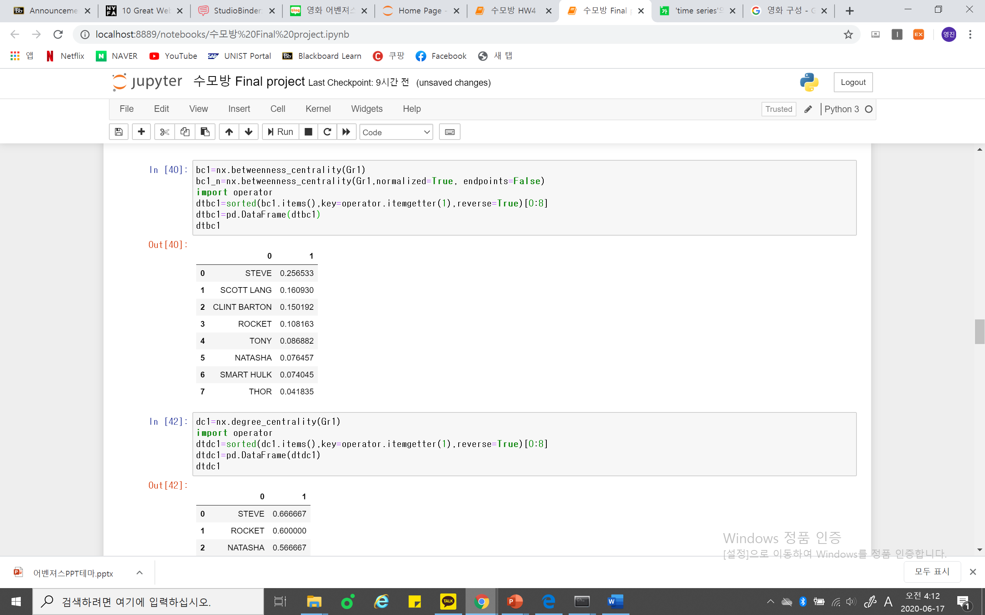
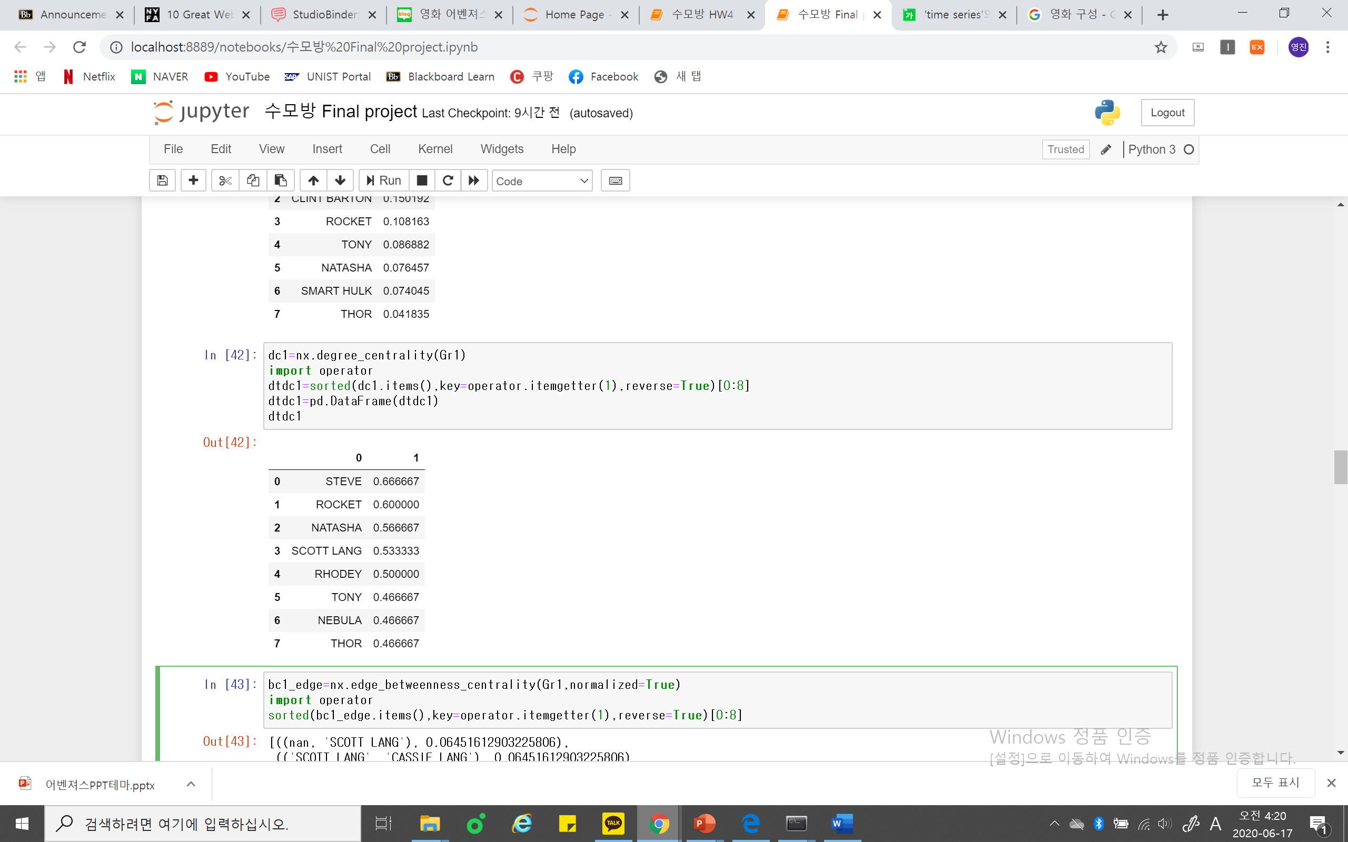
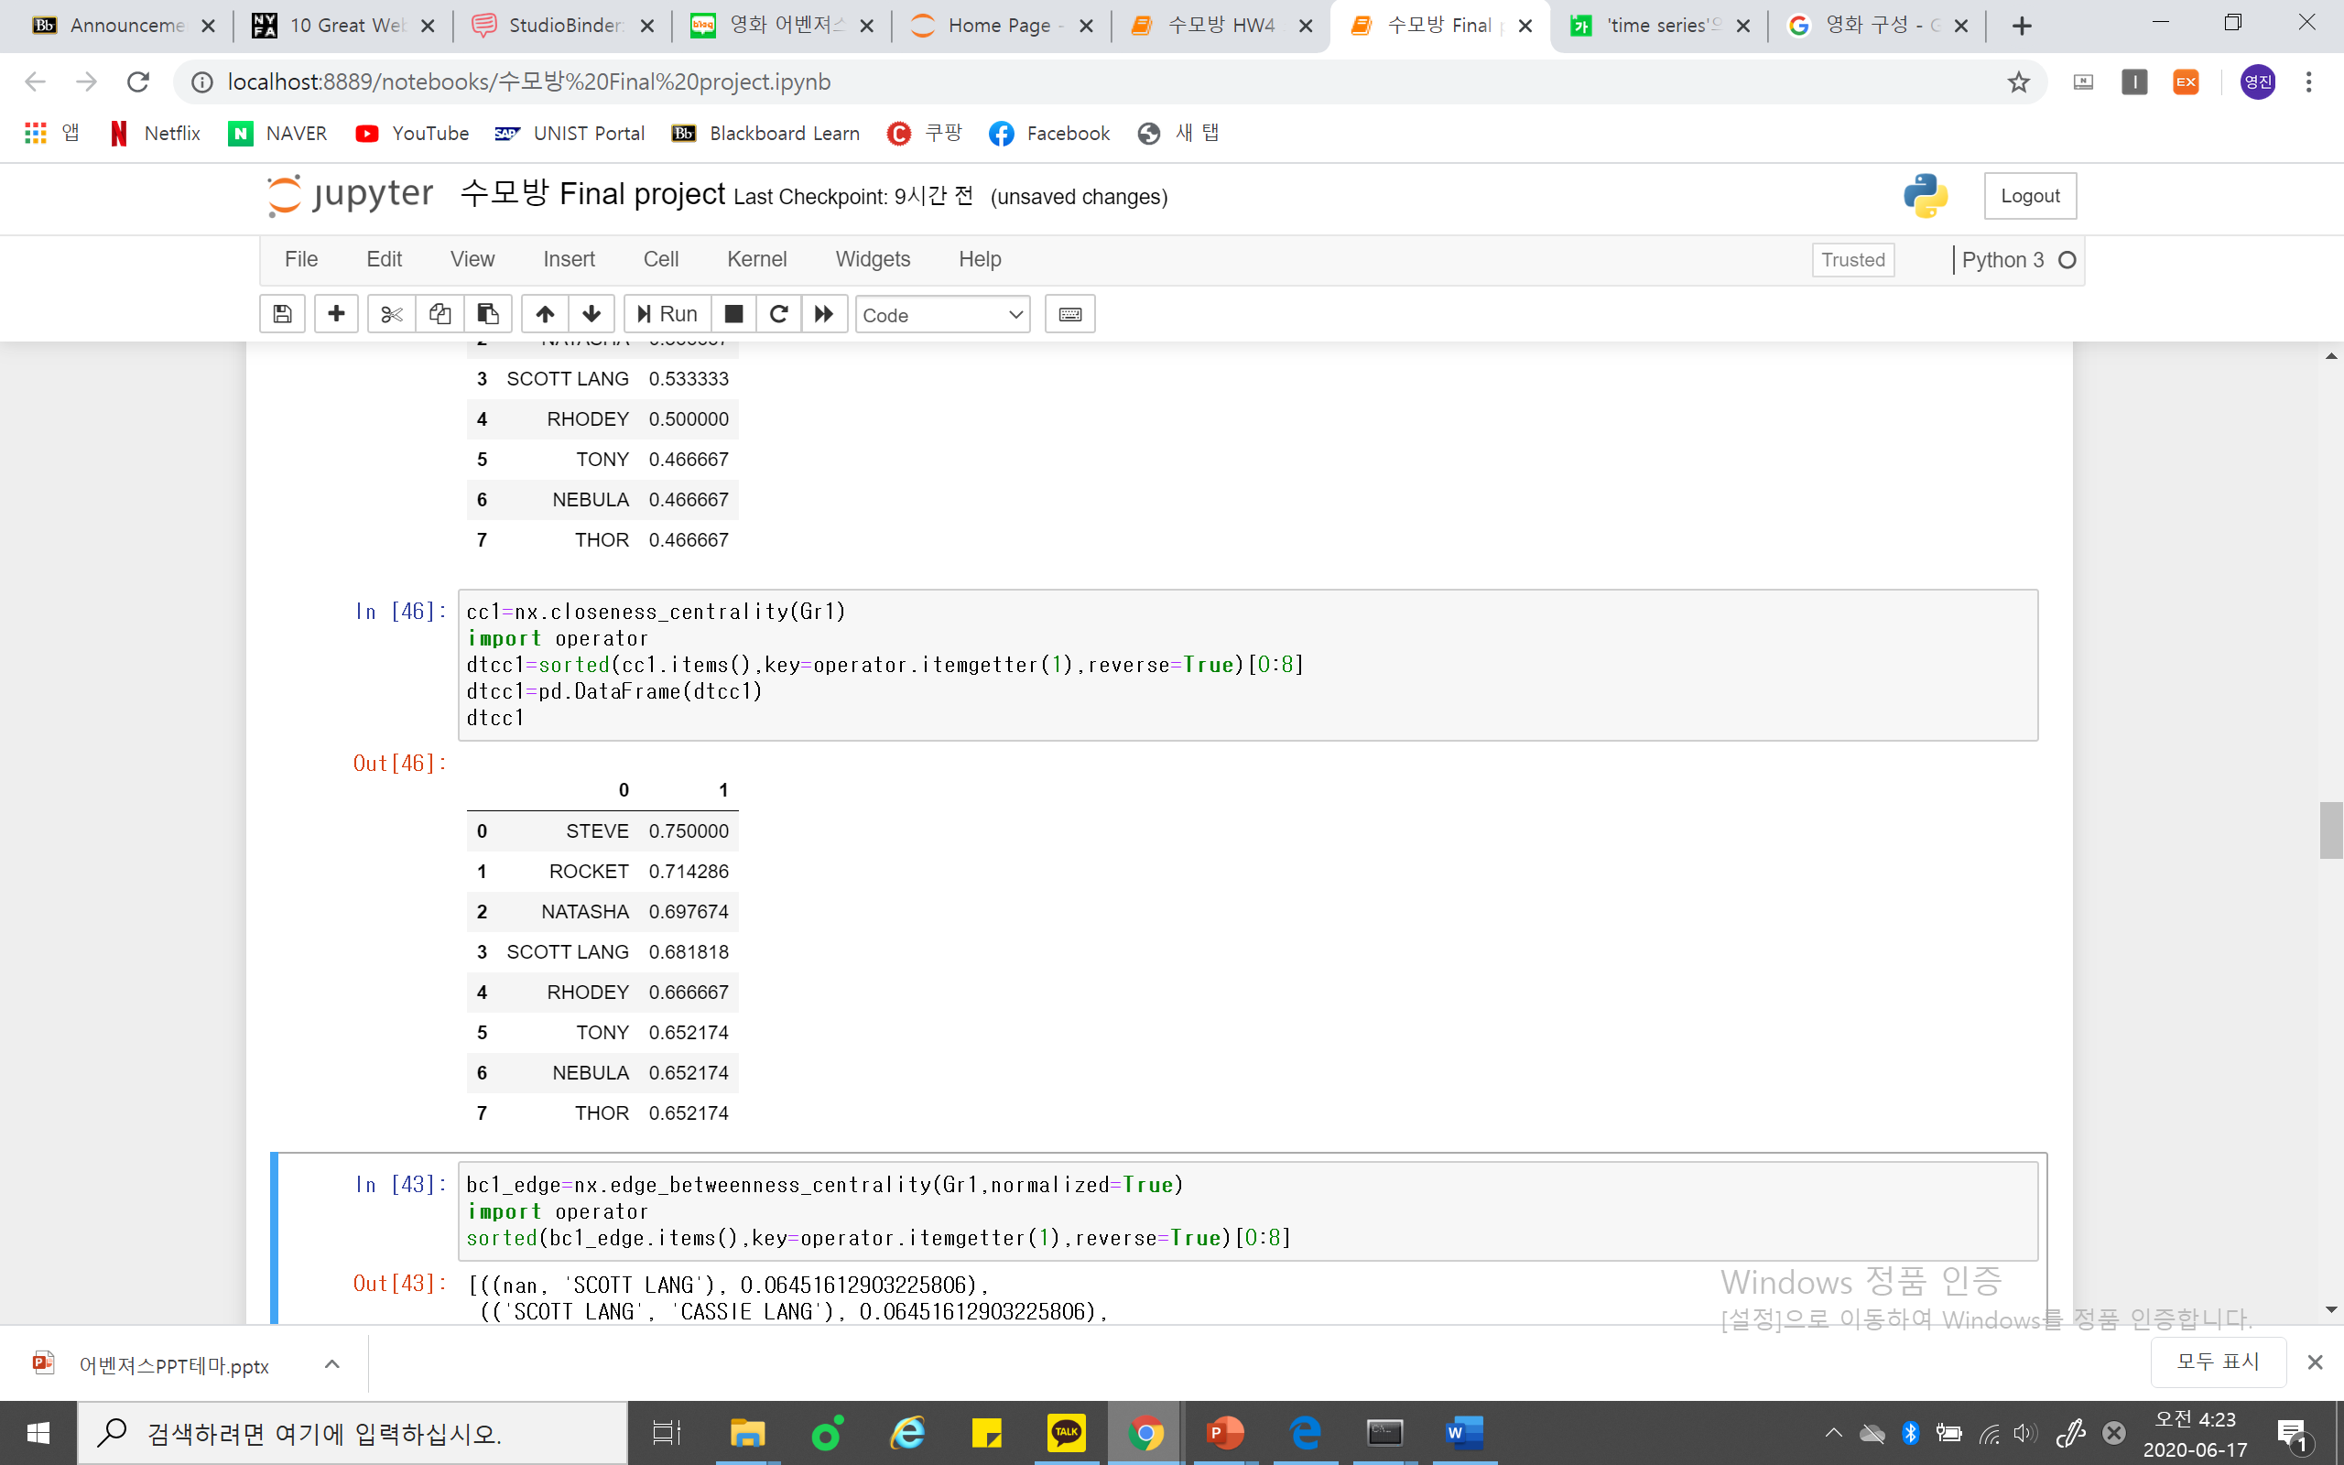
Part 1 : Reunion
Betweenness centrality
Degree centrality
Closeness centrality
It is undoubtful that Steve(Captain America) plays the most important role, which is actually the main character of the whole MARVEL series. He plays the leading role to gather all heroes together and to persuade them to bring back all disappeared people by time travel.
Scott Lang appears to have especially high betweenness centrality than his other centralities, since he suggests the possibility of time travel and persuade avengers to find the way of time travel, which is also an important role.

Slide 6
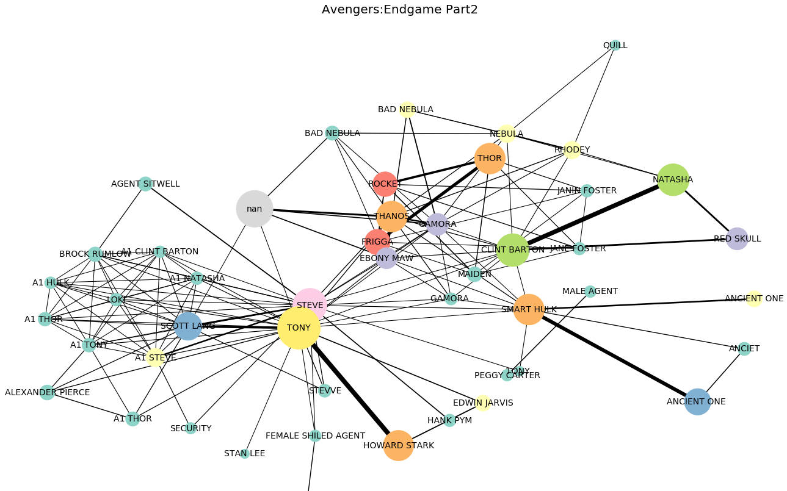
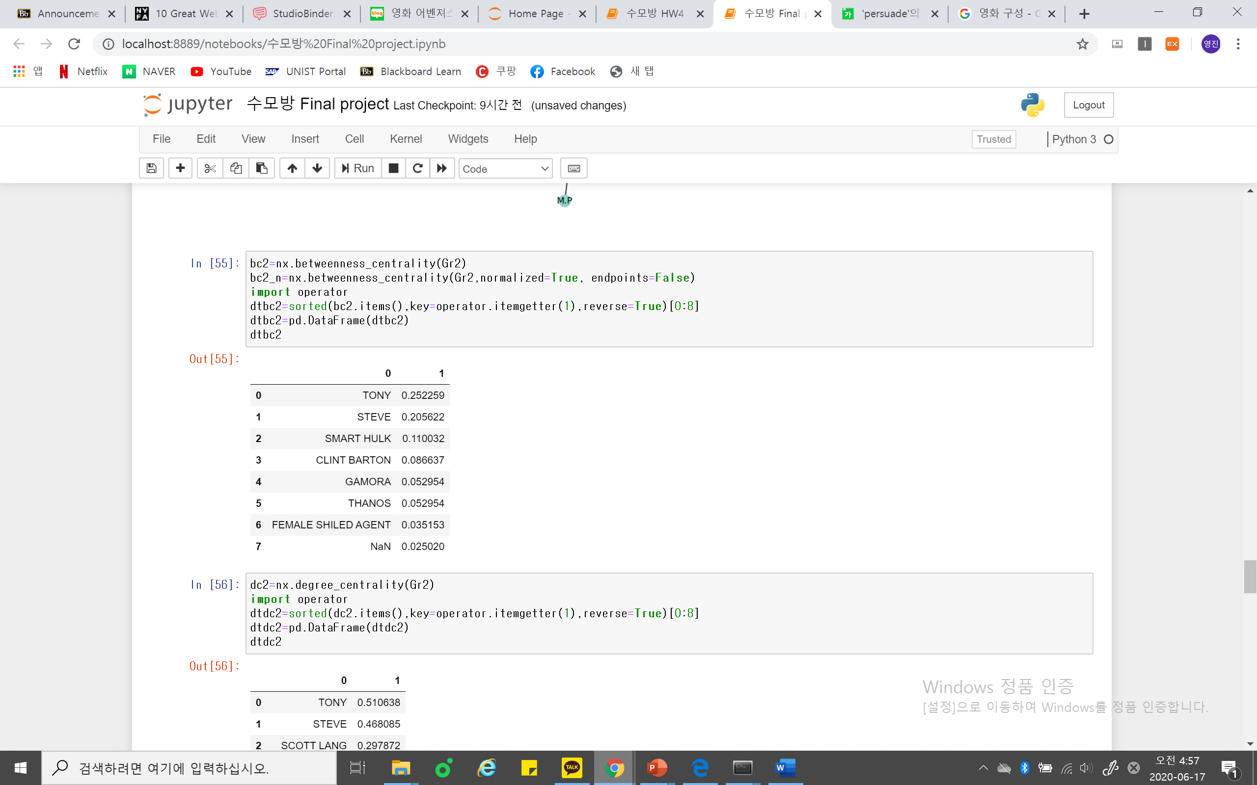
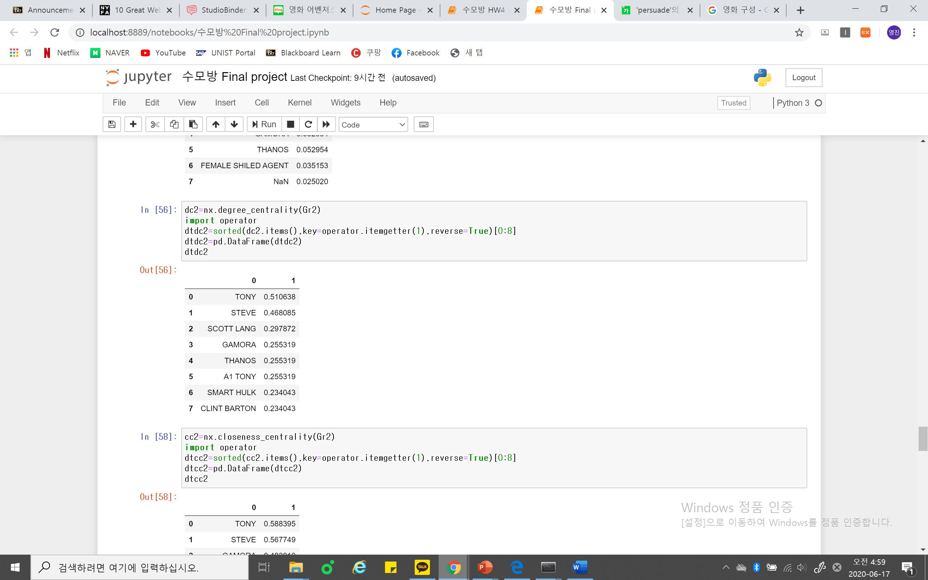
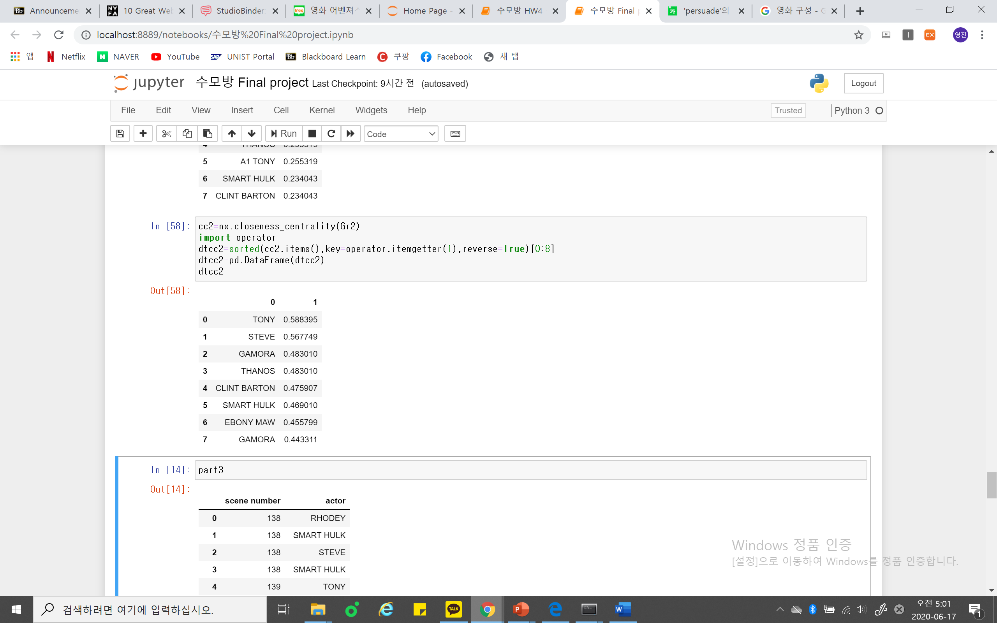
Part 2 : Time Travel
Betweenness centrality
Degree centrality
Closeness centrality
Here, I’ll focus on Degree centralities since in Part2, each characters scattered into each different past. We can find this fact in the network in that characters are somewhat divided into several groups.
Tony(Iron Man) and Steve(Captain America) have high degree centralities.
Each character travels the past which contains reminiscences of Marvel series. Most of those reminiscences are related to Tony and Steve that are in fact the main characters of Marvel series.

Slide 7
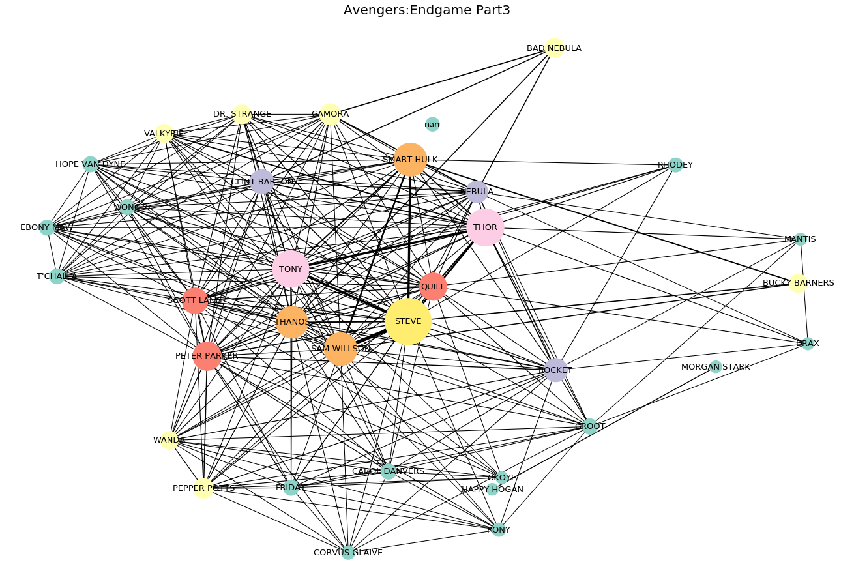
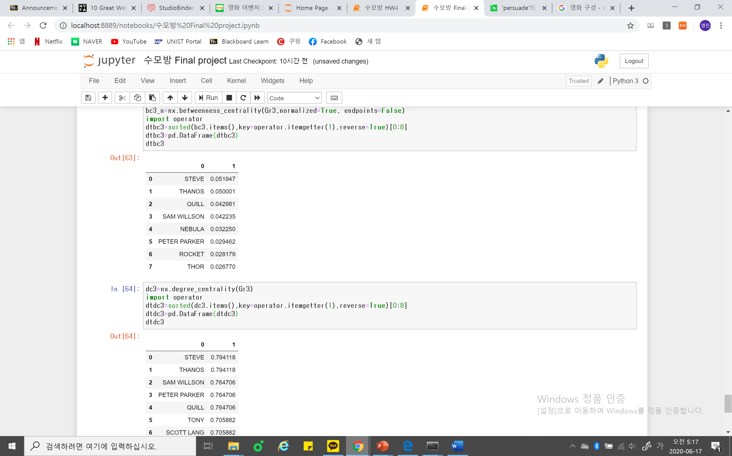
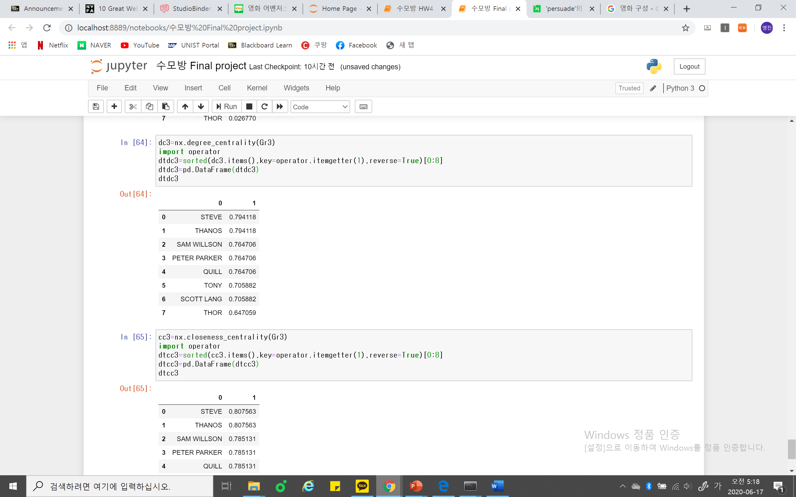
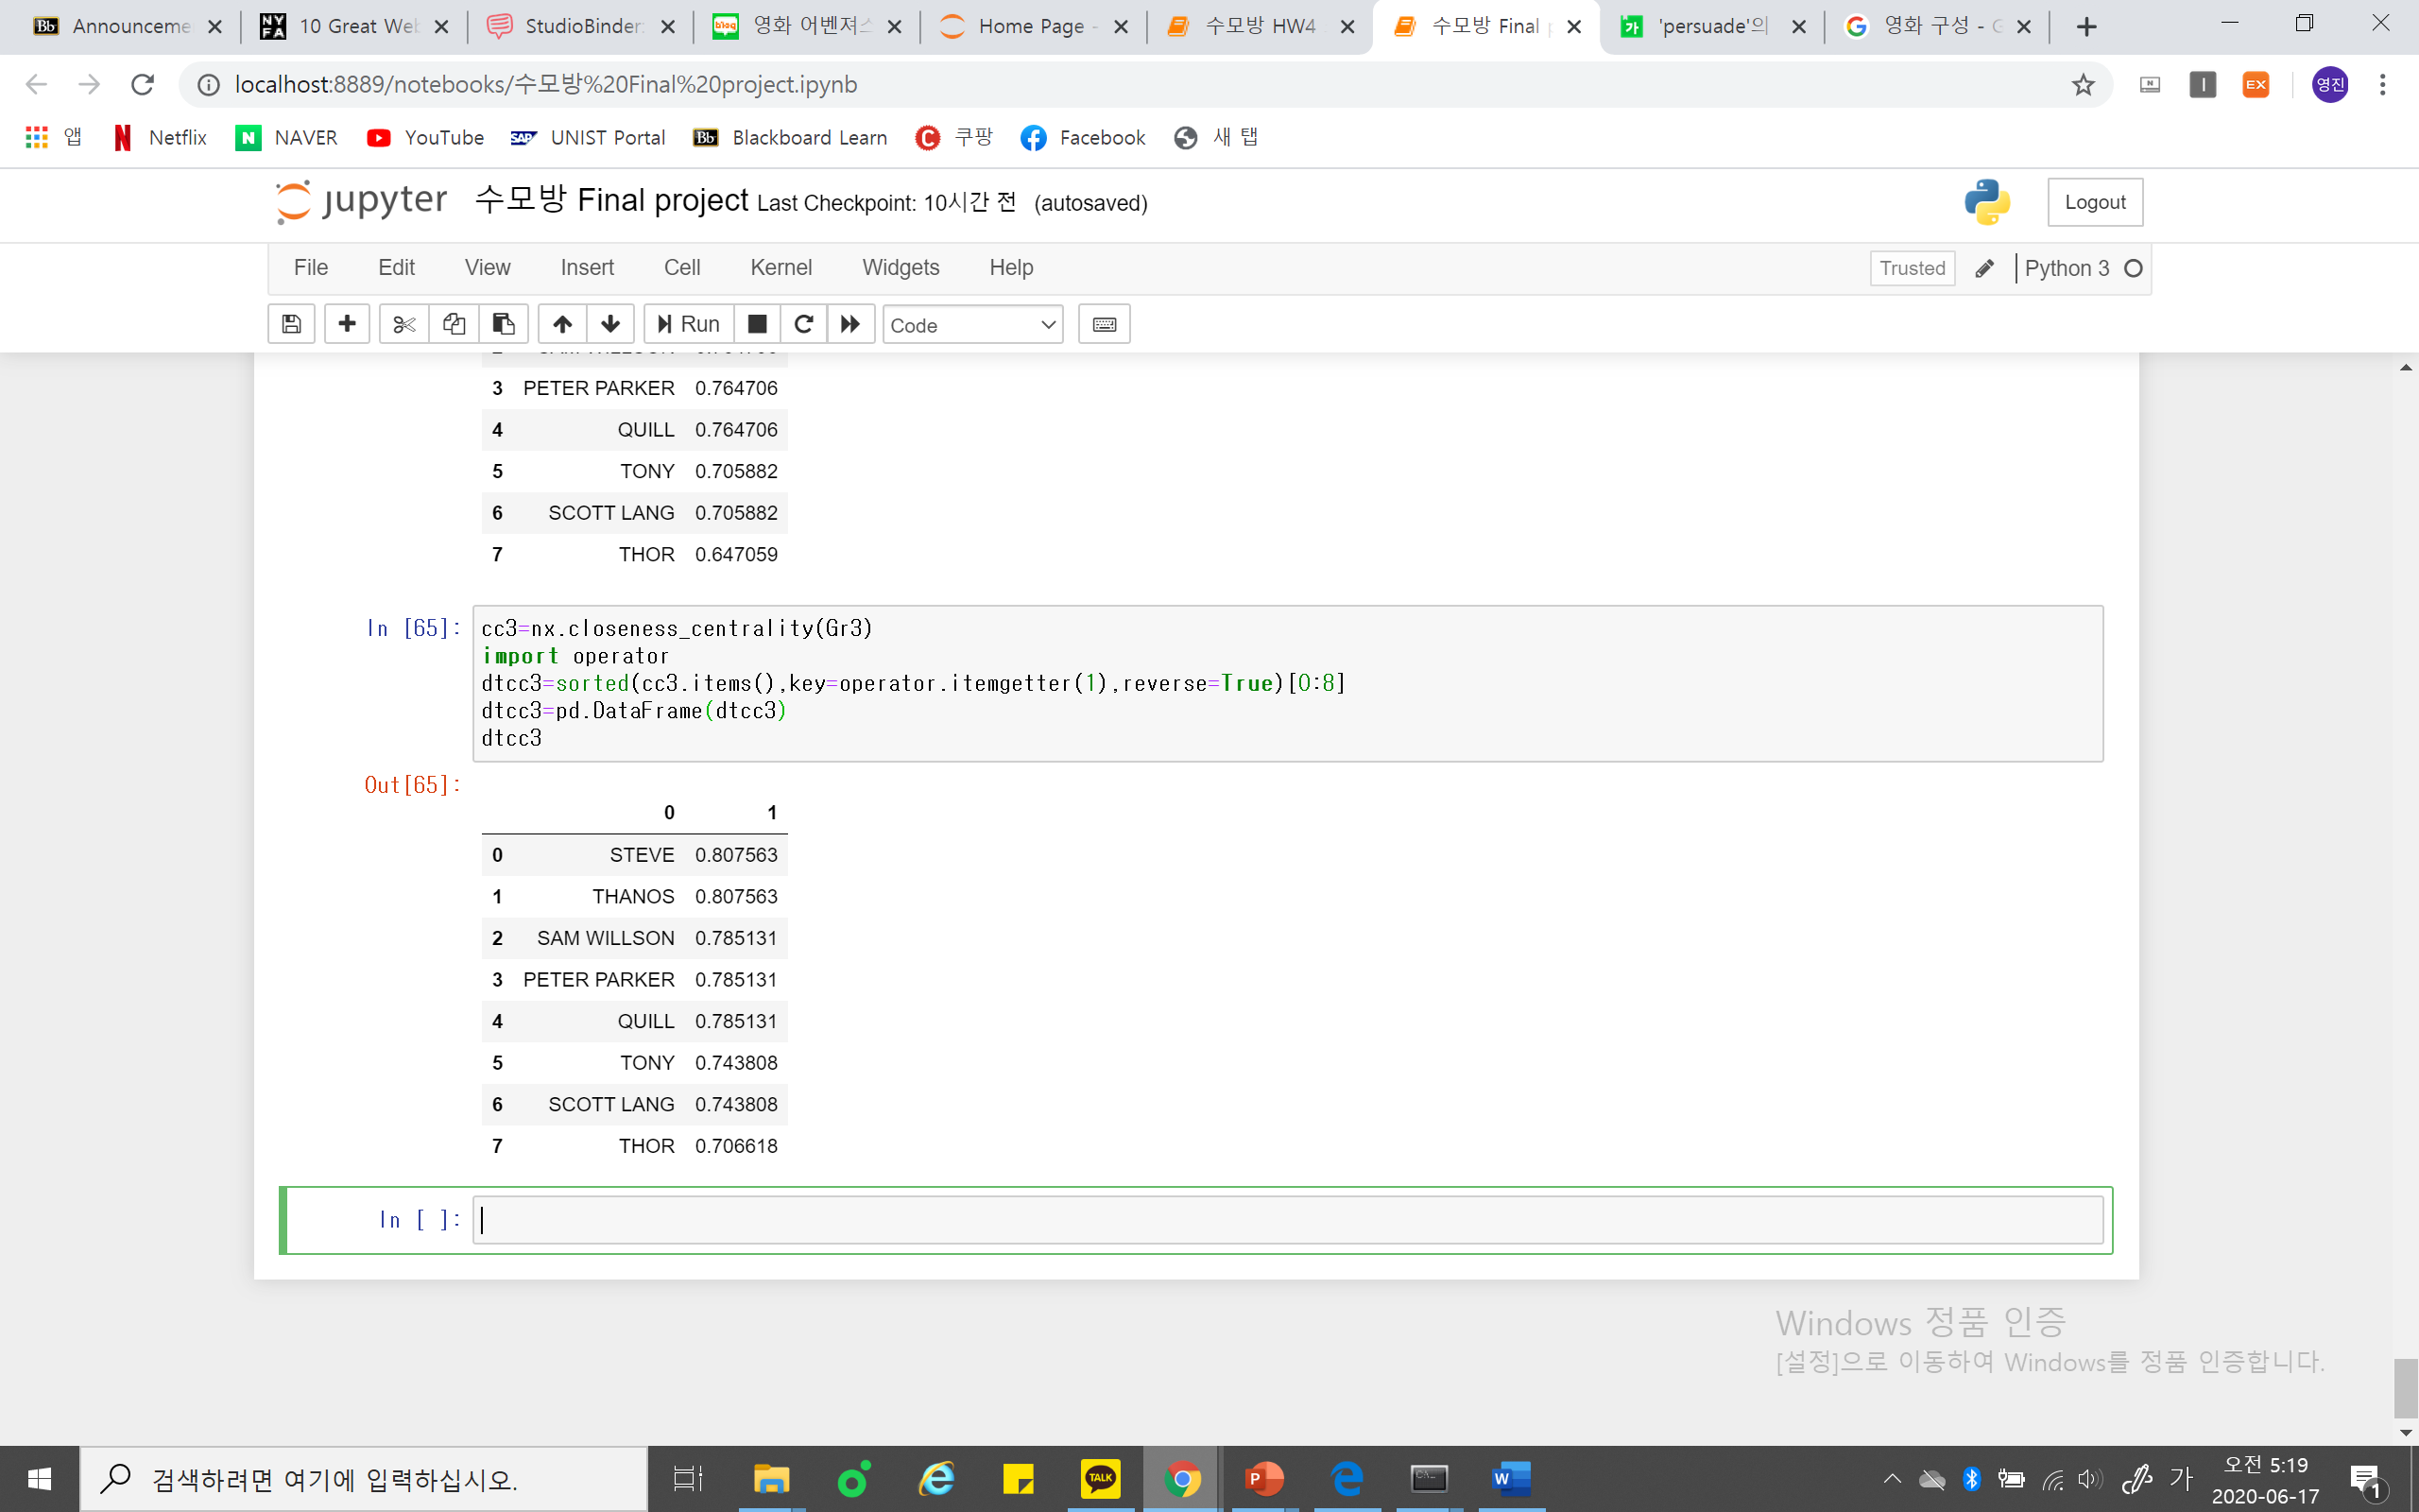
Part 3 : Final Battle
Betweenness centrality
Degree centrality
Closeness centrality
Here, we can find a interesting feature. Every centrality is almost equally distributed. The movie gives us various scenes in almost equal lengths during the enormous final battle to show each character who rose from the ashes are fighting against army of Thanos.
Nevertheless, Steve(Captain America) and Thanos show slightly high centralities. Two characters are the two main symbol of the confliction of whole Marvel series.
Army of Captain America vs. Army of Thanos.

Slide 8
CONCLUSION
We can compare those results with Star Wars series.
Star Wars series, despite its remarkable popularity in other countries, could not make successful hit in Korea.
Unlike Star Wars,
Avengers present its complex fictional world in clear and straight-forward ways.
Heroes are definitely highlighted than other supporting characters, as we can see in each networks.
Among them, once again, some most important heroes,(Tony, Steve, etc) are certainly highlighted than other heroes while not losing its balance among weights of other heroes and their own narrations.
Moreover, each part of the movie has highly distinct structure of network to help understanding of whole synopsis, which is complex and difficult to understand otherwise.

